Slide 1
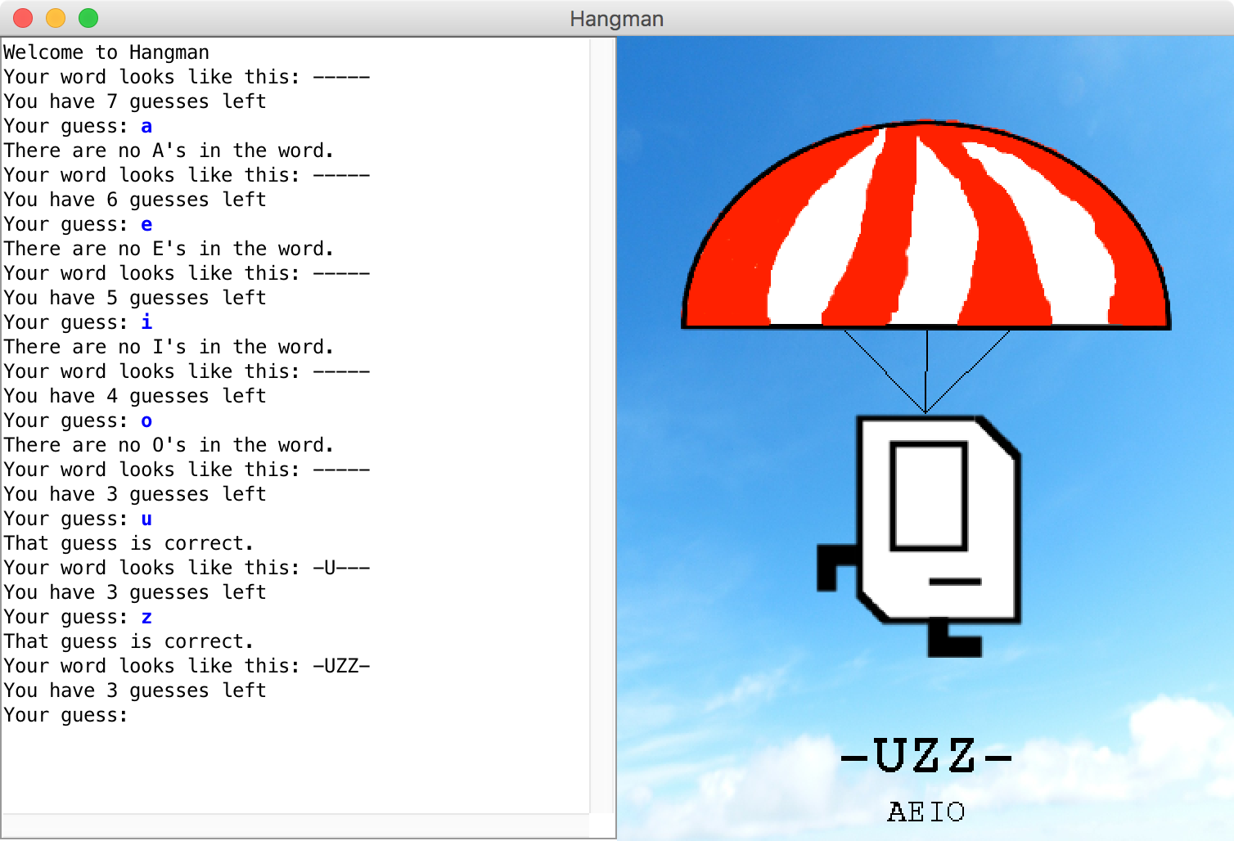

Slide 2

File Reading
Chris Piech
CS106A, Stanford University

Slide 3
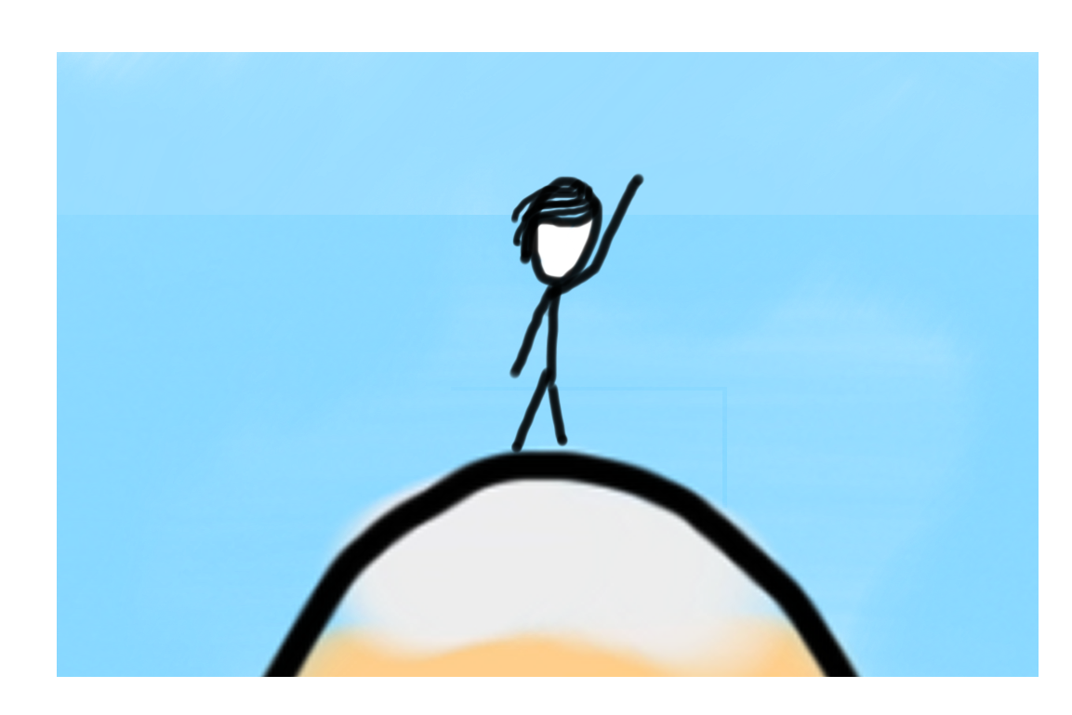
Learning Goals
1. Know how to read a file line by line.

Slide 4
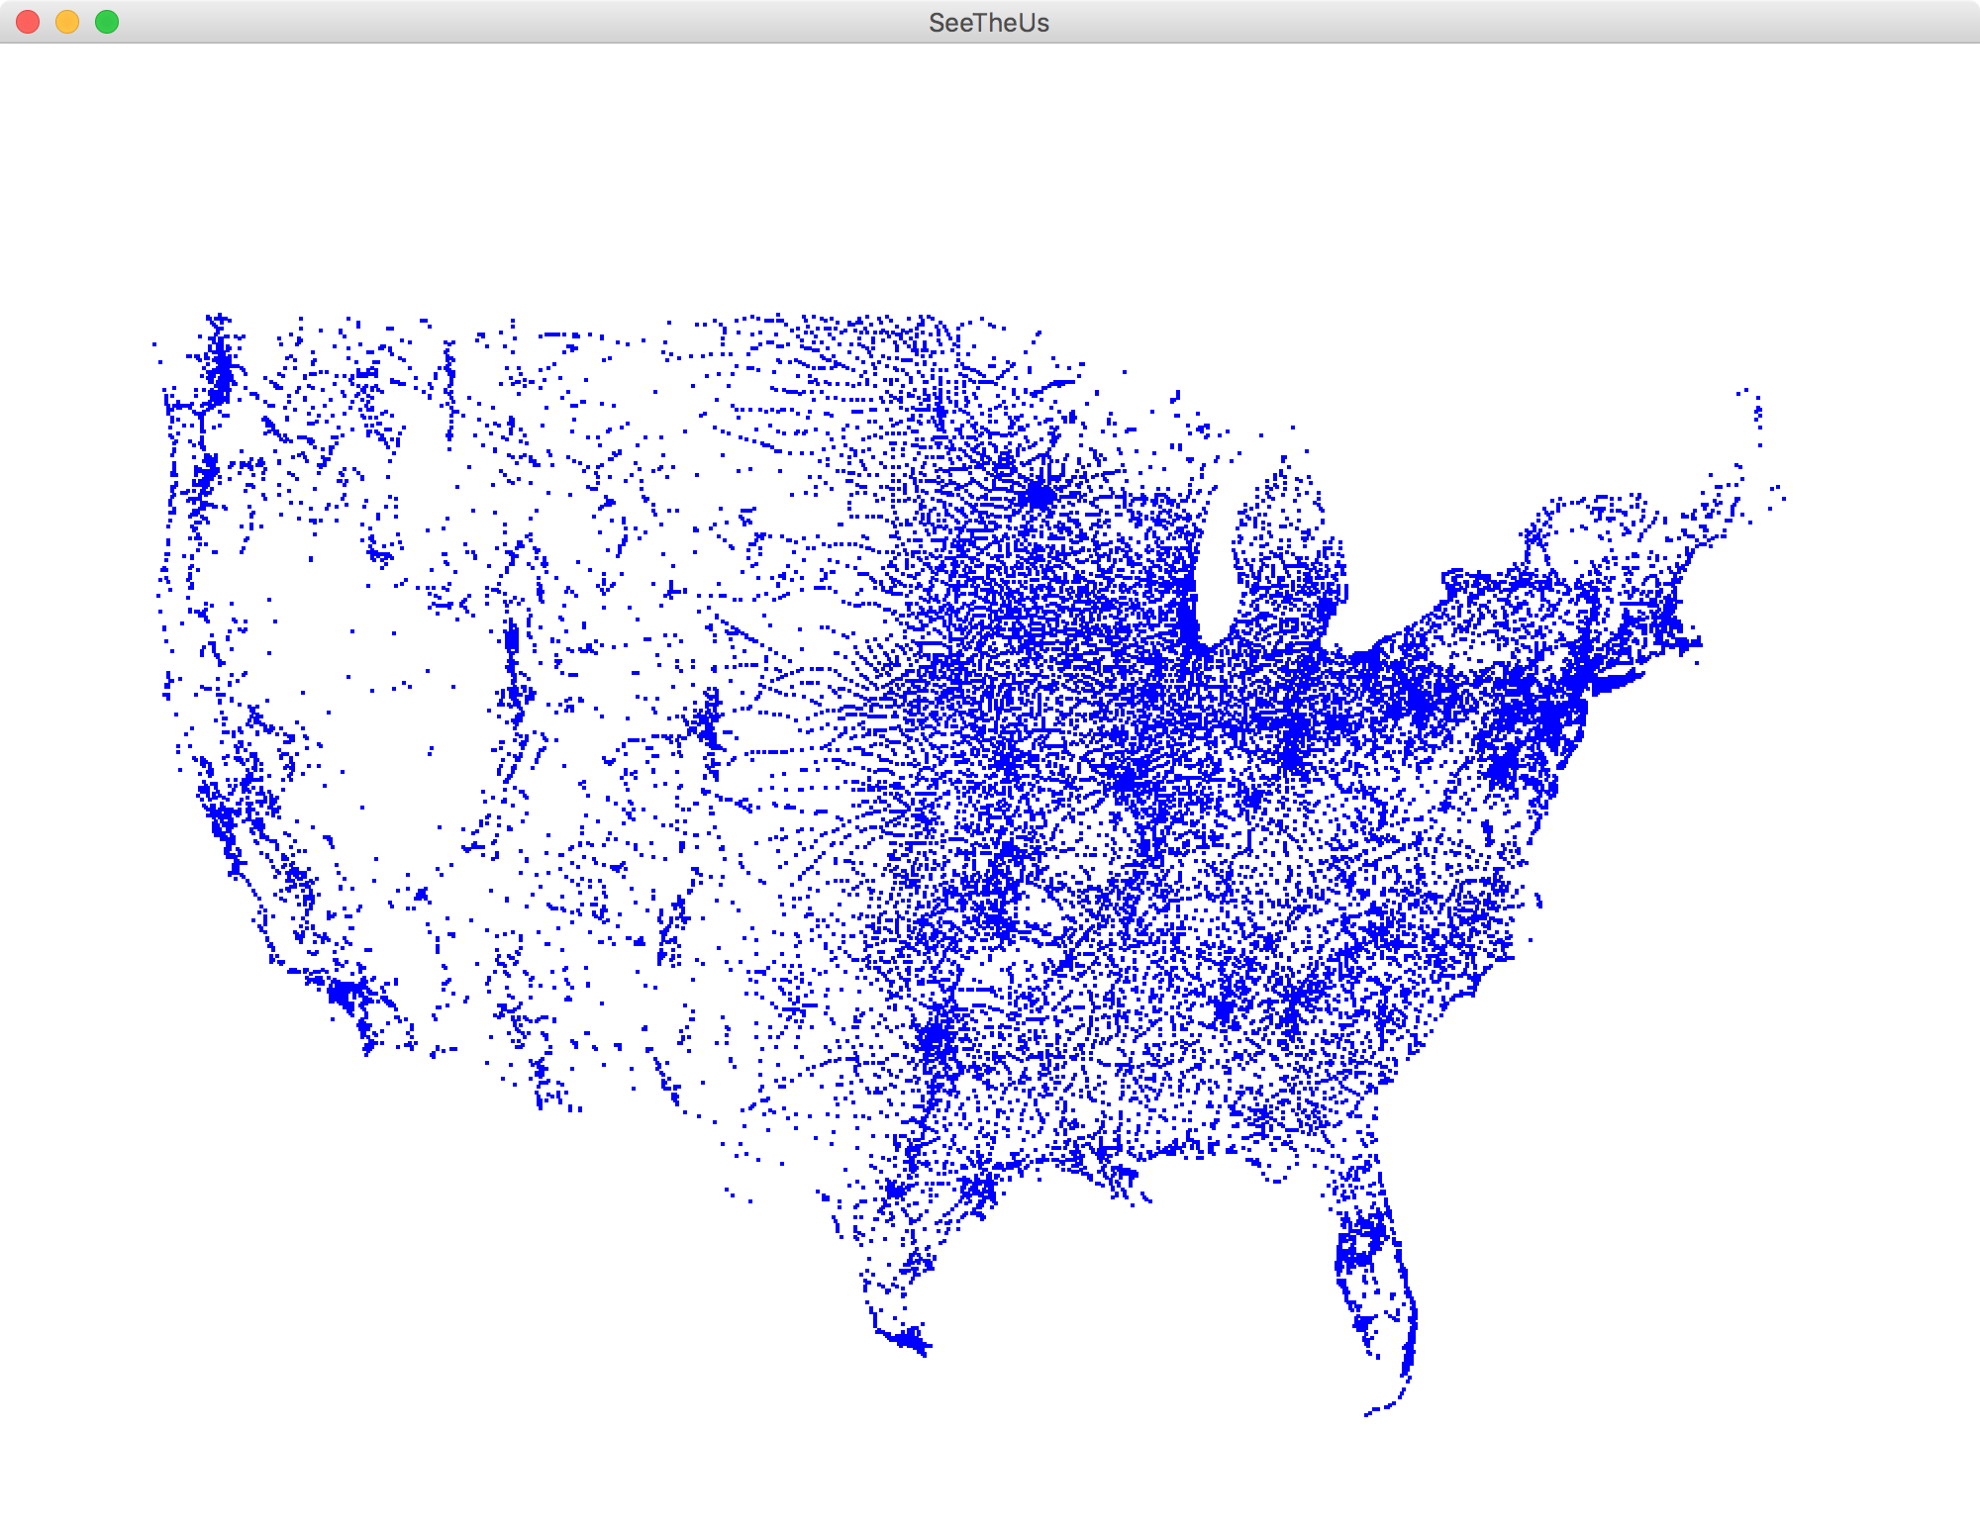
Each blue dot is a tiny GRect

Slide 5

Chris’ Favorite Program
Bright Simons

Slide 6
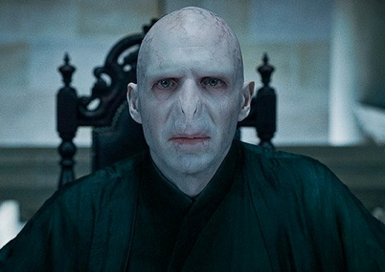
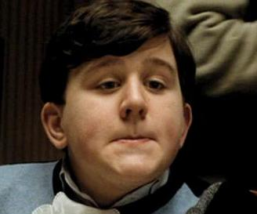

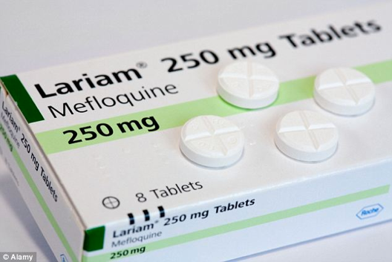
Underlying Puzzle
Counterfeiter
User
You (Distributor)

Slide 7
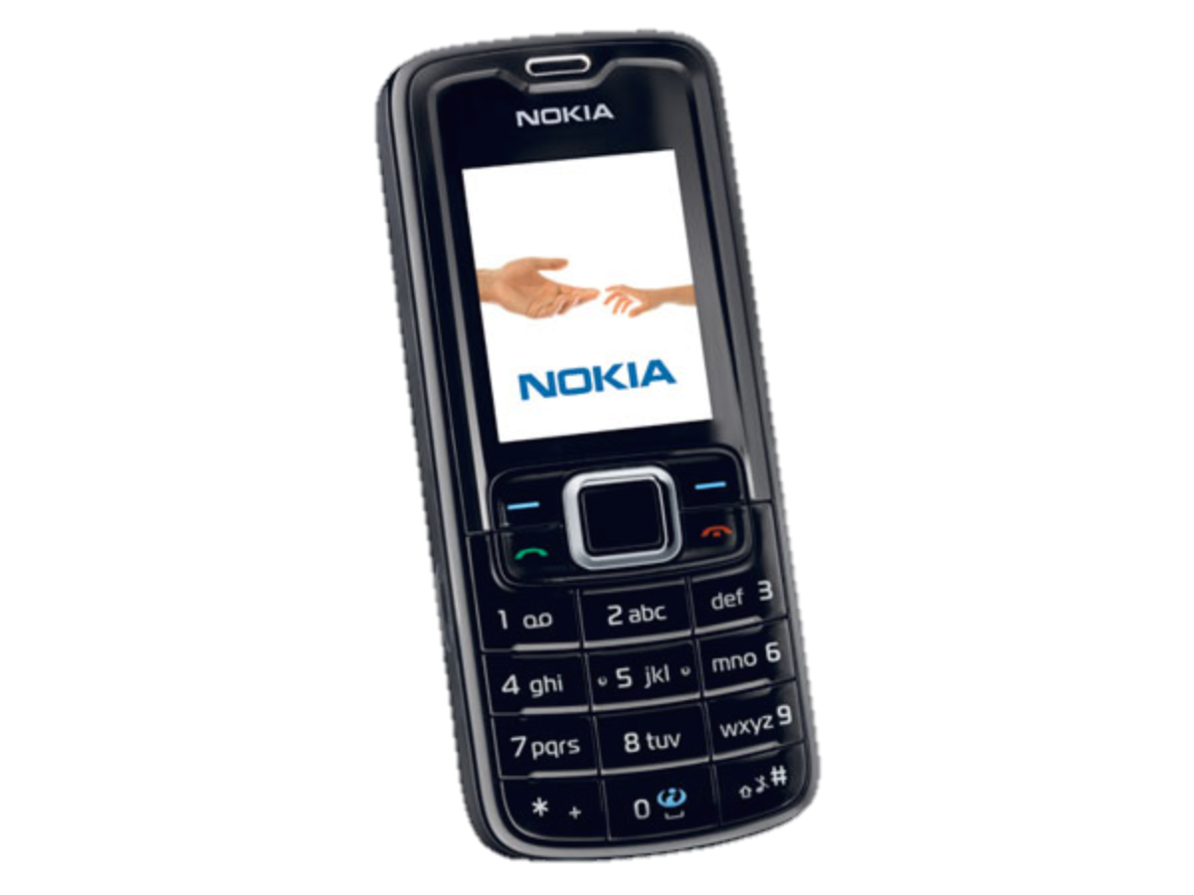
Underlying Puzzle
Counterfeiter
?
User
You (Distributor)

Slide 8
Make a code to
put on every box

Slide 10
1. Unique
2. Impossible to guess

Slide 11
Insight
So that it is impossible to guess
Concatenation
Code
=
RandomNum
+
UniqueNum
So that no two codes are the same

Slide 12
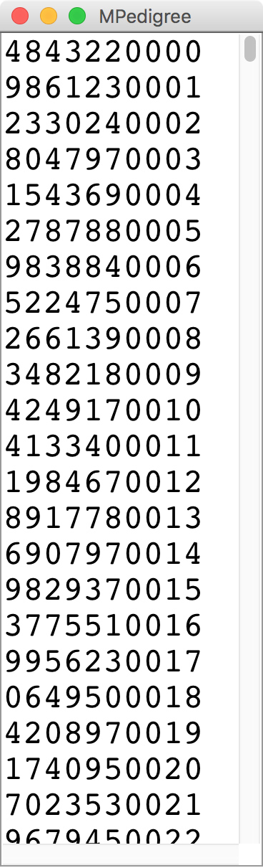
M-Pedigree

Slide 13
How strings are represented
public void run() {
String text = “hello!”;
}
H
e
l
l
o
!
0
1
2
3
4
5

Slide 14
How it is actually stored
public void run() {
String text = “hello!”;
}
stack
heap?
run
28
text
28
Length: 6
H
e
l
l
o
!

Slide 15
H
e
l
l
o
!
0
1
2
3
4
5
text.charAt(index)

Slide 16
Recall Palindromes
Here are some palindromes in other languages:
بلح تعلق تحت قلعة حلب (Dates hang underneath a castle in Halab)
여보, 안경 안보여 (Honey, I can't see my glasses)
कड़क (a loud thunderous sound)
上海自來水來自海上 (Shanghai tap water originates from "above" the ocean)
The comedian Dmitri Martin also has a routine about palindromes; check it out at https://www.youtube.com/watch?v=0hUHDIOazIU

Slide 17
First try
original == reverse
What went wrong?

Slide 18
private boolean isPalindrome(String original) {
String reversed = reverse(original);
return reversed == original;
}
stack
heap
isPalindrome
28
original
28
a
b
b
a
reversed
92
92
a
b
b
a

Slide 19
Use .equals to compare strings, not ==

Slide 20
</ Review>

Slide 21
ATGCTTAAACC..

Slide 22
Human Genome Project
"ATGCCAGGAC"
"GGACTTACATTTTT"
"ATTTTTGGCCGGCC"
The human genome has 3 billion base pairs

Slide 23
Compose Problem
strand1
"ATGCCAGGAG"
strand2
"GGAGTTACATTTTT"
result
"ATGCCAGGAGTTACATTTTT"
The human genome has 3 billion base pairs

Slide 24
Ha. Gene was working on
The Genome project ☺
Did Gene Myers define all those little pieces as constants?

Slide 25
File Processing!
Thanks Keith Schwarz for some great slides to build off!

Slide 26
Getting Data into Programs
Put it directly in the program:
Define constants holding your values.
Get it from the user:
Mouse events, nextLine, etc.
Generate it randomly:
Use a RandomGenerator.
Get it from an external source.
Store it in a file and read it later.
Notes:
Use the example of entering a one-billion-base-pair DNA sequence into a program.

Slide 27
Reading Fiels
Virtually all programs that you've used at some point read files from disk:
Word processing (documents)
Web browser (cookies)
Games (saved progress)
Eclipse (Java files)
Music player (songs)

Slide 28
The structure of files
A file is just a series of bits (ones and zeros).
Those bits can have structure:
Plain-text: Bits represent characters.
JPEG: Bits encode information about the structure of an image.
MP3: Bits encode frequency information about music.
etc.

Slide 29
The structure of files
A file is just a series of bits (ones and zeros).
Those bits can have structure:
Plain-text: Bits represent characters.
JPEG: Bits encode information about the structure of an image.
MP3: Bits encode frequency information about music.
etc.

Slide 30
Yesterday, upon the stair,
I met a man who wasn’t there
He wasn’t there again today
I wish, I wish he’d go away...
- Hughes Mearns, "Antagonish"

Slide 31
Yesterday, upon the stair,
I met a man who wasn’t there
He wasn’t there again today
I wish, I wish he’d go away...
- Hughes Mearns, "Antagonish"
Step one:
Open the file for reading.

Slide 32
Reading in a File
Yesterday, upon the stair,
I met a man who wasn’t there
He wasn’t there again today
I wish, I wish he’d go away...
- Hughes Mearns, "Antagonish"
Scanner input = new Scanner(new File("mydata.txt"));

Slide 33
Reading in a File
Yesterday, upon the stair,
I met a man who wasn’t there
He wasn’t there again today
I wish, I wish he’d go away...
- Hughes Mearns, "Antagonish"
Scanner input = new Scanner(new File("mydata.txt"));
import java.util.*; // for Scanner
import java.io.*; // for File

Slide 34
Reading in a File
Yesterday, upon the stair,
I met a man who wasn’t there
He wasn’t there again today
I wish, I wish he’d go away...
- Hughes Mearns, "Antagonish"
Scanner input = new Scanner(new File("mydata.txt"));
Step Two:
Read the file, one line at a time.

Slide 35
Reading in a File
Yesterday, upon the stair,
I met a man who wasn’t there
He wasn’t there again today
I wish, I wish he’d go away...
- Hughes Mearns, "Antagonish"
Scanner input = new Scanner(new File("mydata.txt"));
// Yesterday, upon the stair
String line1 = input.nextLine();

Slide 36
Reading in a File
Yesterday, upon the stair,
I met a man who wasn’t there
He wasn’t there again today
I wish, I wish he’d go away...
- Hughes Mearns, "Antagonish"
Scanner input = new Scanner(new File("mydata.txt"));
// Yesterday, upon the stair
String line1 = input.nextLine();

Slide 37
Reading in a File
Yesterday, upon the stair,
I met a man who wasn’t there
He wasn’t there again today
I wish, I wish he’d go away...
- Hughes Mearns, "Antagonish"
Scanner input = new Scanner(new File("mydata.txt"));
// Yesterday, upon the stair
String line1 = input.nextLine();
// I met a man who wasn't there
String line2 = input.nextLine();
Notes:
Forgets past lines! (Gumball machine)

Slide 38
Reading in a File
Yesterday, upon the stair,
I met a man who wasn’t there
He wasn’t there again today
I wish, I wish he’d go away...
- Hughes Mearns, "Antagonish"
Scanner input = new Scanner(new File("mydata.txt"));
// "Yesterday, upon the stair"
String line1 = input.nextLine();
// I met a man who wasn't there
String line2 = input.nextLine();

Slide 39
Reading in a File
Yesterday, upon the stair,
I met a man who wasn’t there
He wasn’t there again today
I wish, I wish he’d go away...
- Hughes Mearns, "Antagonish"
Scanner input = new Scanner(new File("mydata.txt"));
...
// He wasn't there again today
String line3 = input.nextLine();

Slide 40
Reading in a File
Yesterday, upon the stair,
I met a man who wasn’t there
He wasn’t there again today
I wish, I wish he’d go away...
- Hughes Mearns, "Antagonish"
Scanner input = new Scanner(new File("mydata.txt"));
...
// He wasn't there again today
String line3 = input.nextLine();

Slide 41
Reading in a File
Yesterday, upon the stair,
I met a man who wasn’t there
He wasn’t there again today
I wish, I wish he’d go away...
- Hughes Mearns, "Antagonish"
Scanner input = new Scanner(new File("mydata.txt"));
...
// He wasn't there again today
String line3 = input.nextLine();
// I wish, I wish he'd go away
String line4 = input.nextLine();

Slide 42
Reading in a File
Yesterday, upon the stair,
I met a man who wasn’t there
He wasn’t there again today
I wish, I wish he’d go away...
- Hughes Mearns, "Antagonish"
Scanner input = new Scanner(new File("mydata.txt"));
...
// He wasn't there again today
String line3 = input.nextLine();
// I wish, I wish he'd go away
String line4 = input.nextLine();

Slide 43
Reading in a File
Yesterday, upon the stair,
I met a man who wasn’t there
He wasn’t there again today
I wish, I wish he’d go away...
- Hughes Mearns, "Antagonish"
Scanner input = new Scanner(new File("mydata.txt"));
...
// - Hughes Mearns, "Antagonish"
String line5 = input.nextLine();

Slide 44
Reading in a File
Yesterday, upon the stair,
I met a man who wasn’t there
He wasn’t there again today
I wish, I wish he’d go away...
- Hughes Mearns, "Antagonish"
Scanner input = new Scanner(new File("mydata.txt"));
...
// - Hughes Mearns, "Antagonish"
String line5 = input.nextLine();

Slide 45
Reading in a File
Yesterday, upon the stair,
I met a man who wasn’t there
He wasn’t there again today
I wish, I wish he’d go away...
- Hughes Mearns, "Antagonish"
Scanner input = new Scanner(new File("mydata.txt"));
...
// - Hughes Mearns, "Antagonish"
String line5 = input.nextLine();
Notes:
But what if we don’t know the number of lines!

Slide 46
Reading in a File
Yesterday, upon the stair,
I met a man who wasn’t there
He wasn’t there again today
I wish, I wish he’d go away...
- Hughes Mearns, "Antagonish"
Scanner input = new Scanner(new File("mydata.txt"));
...
// prints all lines in the file
while (input.hasNextLine()) {
String line = input.nextLine();
println(line);
}

Slide 47
Reading in a File
Yesterday, upon the stair,
I met a man who wasn’t there
He wasn’t there again today
I wish, I wish he’d go away...
- Hughes Mearns, "Antagonish"
Scanner input = new Scanner(new File("mydata.txt"));
...
// prints all lines in the file
while (input.hasNextLine()) {
String line = input.nextLine();
println(line);
}
Step Three: close the file.

Slide 48
Reading in a File
Yesterday, upon the stair,
I met a man who wasn’t there
He wasn’t there again today
I wish, I wish he’d go away...
- Hughes Mearns, "Antagonish"
Scanner input = new Scanner(new File("mydata.txt"));
...
// prints all lines in the file
while (input.hasNextLine()) {
String line = input.nextLine();
println(line);
}
input.close();

Slide 49
Scanner Methods
Method | Description
sc.nextLine() | reads and returns a one-line String from the file
sc.next() | reads and returns a one-word String from the file
sc.nextInt() | reads and returns an int from the file
sc.nextDouble() | reads and returns a double from the file
sc.hasNextLine() | returns true if there are any more lines
sc.hasNext() | returns true if there are any more tokens
sc.hasNextInt() | returns true if there is a next token and it's an int
sc.hasNextDouble() | returns true if there is a next token and it's a double
sc.close(); | should be called when done reading the file

Slide 50
Let “try” it out!
Thanks Keith Schwarz for some great slides to build off!

Slide 51
There’s a “catch”
Thanks Keith Schwarz for some great slides to build off!

Slide 52
Sometimes things break
Programs sometimes encounter unexpected errors.
Sometimes these are bugs:
Dividing by zero.
Sending a message to a null object.
Sometimes these are due to external factors:
Network errors.
Missing files.

Slide 53
Exceptional cases
If Java encounters a case where it can't proceed as normal, it will cause an exception.
Java requires that your program handle certain types of exceptions.
Think of exceptions as rerouting control in an emergency:
If all goes well, program continues as usual.
If something goes wrong, handle the emergency.

Slide 54
Let “try” it out!
Thanks Keith Schwarz for some great slides to build off!

Slide 55
Let try it out!
Thanks Keith Schwarz for some great slides to build off!

Slide 56
try-ing your best
To use a method or class that might cause an exception, you need to tell Java to try its best, knowing that it might fail.

Slide 57
try-ing your best
To use a method or class that might cause an exception, you need to tell Java to try its best, knowing that it might fail.
try {
Scanner input =
new Scanner(new File("poem.txt"));
String line1 = input.nextLine(); // Yesterday, upon the stair,
String line2 = input.nextLine(); // I met a man who wasn't there
String line3 = input.nextLine(); // He wasn't there again today
String line4 = input.nextLine(); // I wish, I wish he'd go away...
String line5 = input.nextLine(); // - Hughes Mearns, "Antagonish"
String line6 = input.nextLine(); // *Returns null*
input.close();
}

Slide 58
try-ing your best
To use a method or class that might cause an exception, you need to tell Java to try its best, knowing that it might fail.
try {
Scanner input =
new Scanner(new File("poem.txt"));
String line1 = input.nextLine(); // Yesterday, upon the stair,
String line2 = input.nextLine(); // I met a man who wasn't there
String line3 = input.nextLine(); // He wasn't there again today
String line4 = input.nextLine(); // I wish, I wish he'd go away...
String line5 = input.nextLine(); // - Hughes Mearns, "Antagonish"
String line6 = input.nextLine(); // *Returns null*
input.close();
}

Slide 59
There’s a “catch”
Thanks Keith Schwarz for some great slides to build off!

Slide 60
There’s a catch
Thanks Keith Schwarz for some great slides to build off!

Slide 61
try and catch me
If an exception occurs, you may need to tell Java to catch that exception.

Slide 62
try and catch me
If an exception occurs, you may need to tell Java to catch that exception.
try {
Scanner input =
new Scanner(new File("poem.txt"));
String line1 = input.nextLine(); // Yesterday, upon the stair,
String line2 = input.nextLine(); // I met a man who wasn't there
String line3 = input.nextLine(); // He wasn't there again today
String line4 = input.nextLine(); // I wish, I wish he'd go away...
String line5 = input.nextLine(); // - Hughes Mearns, "Antagonish"
String line6 = input.nextLine(); // *Returns null*
input.close();
}

Slide 63
try and catch me
If an exception occurs, you may need to tell Java to catch that exception.
try {
Scanner input =
new Scanner(new File("poem.txt"));
String line1 = input.nextLine(); // Yesterday, upon the stair,
String line2 = input.nextLine(); // I met a man who wasn't there
String line3 = input.nextLine(); // He wasn't there again today
String line4 = input.nextLine(); // I wish, I wish he'd go away...
String line5 = input.nextLine(); // - Hughes Mearns, "Antagonish"
String line6 = input.nextLine(); // *Returns null*
input.close();
} catch (IOException e) {
println("An error occurred: " + e);
}

Slide 64
try and catch me
If an exception occurs, you may need to tell Java to catch that exception.
If something
fails up here…
try {
Scanner input =
new Scanner(new File("poem.txt"));
String line1 = input.nextLine(); // Yesterday, upon the stair,
String line2 = input.nextLine(); // I met a man who wasn't there
String line3 = input.nextLine(); // He wasn't there again today
String line4 = input.nextLine(); // I wish, I wish he'd go away...
String line5 = input.nextLine(); // - Hughes Mearns, "Antagonish"
String line6 = input.nextLine(); // *Returns null*
input.close();
} catch (IOException e) {
println("An error occurred: " + e);
}

Slide 65
try and catch me
If an exception occurs, you may need to tell Java to catch that exception.
If something
fails up here…
try {
Scanner input =
new Scanner(new File("poem.txt"));
String line1 = input.nextLine(); // Yesterday, upon the stair,
String line2 = input.nextLine(); // I met a man who wasn't there
String line3 = input.nextLine(); // He wasn't there again today
String line4 = input.nextLine(); // I wish, I wish he'd go away...
String line5 = input.nextLine(); // - Hughes Mearns, "Antagonish"
String line6 = input.nextLine(); // *Returns null*
input.close();
} catch (IOException e) {
println("An error occurred: " + e);
}
… we immediately jump down here.

Slide 66
try and catch me
If an exception occurs, you may need to tell Java to catch that exception.
If something
fails up here…
try {
Scanner input =
new Scanner(new File("poem.txt"));
String line1 = input.nextLine(); // Yesterday, upon the stair,
String line2 = input.nextLine(); // I met a man who wasn't there
String line3 = input.nextLine(); // He wasn't there again today
String line4 = input.nextLine(); // I wish, I wish he'd go away...
String line5 = input.nextLine(); // - Hughes Mearns, "Antagonish"
String line6 = input.nextLine(); // *Returns null*
input.close();
} catch (IOException e) {
throw new RuntimeException(e);
}
… we immediately jump down here.

Slide 67
File concepts in one slide
Make a Scanner (lets call it input) to open a file for reading
Use scanner.nextLine to get one line from the file
Both the above operations are “dangerous” so we need to use a try/catch loop
You can either handle the problem or throw a runtime exception
Scanner input = new Scanner(new File("poem.txt"));
input.nextLine(); // returns the next line
try{
// live dangerously
} catch (Exception e){
// have heath insurance
}
throw new RuntimeException(“AHHHH!”);

Slide 68
lets throw it all together.
Thanks Keith Schwarz for some great slides to build off!

Slide 69
The classic file reading program.
The idiomatic “read all the lines of a file” code is shown here:
try {
Scanner input = /*…open the file… */
while (input.hasNextLine()) {
String line = input.nextLine();
/* … process current line … */
}
input.close();
} catch (IOException e) {
throw new RuntimeException(e);
}
Understanding this code is about 95% of what we want you to know for files in CS106A

Slide 70
US Census Data
Thanks Keith for the cool dataset

